Slide 1

Athena CredXpert
…Unlocking India’s True Credit Potential

Slide 2

India’s Silent Credit Crisis
Credit Scores are shaping financial futures, yet most Indians are not aware of their score.
Current Reality
Hidden Impact
79% of approved loans go to people with a Credit Score of 750+
Borrowers with lower scores are systematically excluded or are charged a higher interest rate
68% of borrowers do not know their Credit Score
Credit Scores continuously drop without borrower awareness
76% do not know the interest rate on their loans
Poor credit behavior goes completely unnoticed
Source: ETBFSI, CIBIL Blog, Mirae Asset Finance

Slide 3
The Hidden Struggle of Non-Individuals
Businesses credit health is just as critical - but rarely monitored. In India, Non-Individuals depend heavily on credit for survival and growth. However, most borrowers are not even aware that they have a Credit Report and a Credit Rank.
Current Reality
Hidden Impact
Non-Individual Credit Reports are rarely monitored
Errors or misreporting quietly damage credibility with lenders
Most Non-Individuals are unaware of how their credit profile is evaluated
They end up paying higher interest or losing out on cheaper funds
Weak credit hygiene goes unchecked in daily operations
Over time, this can block access to formal credit altogether

Slide 4




The Vicious Cycle
Low Credit Scores / Ranks set off a vicious cycle, for Individuals and Non-Individuals alike, that keeps worsening over time.
Loan Application Rejection
Low Credit Score / Rank
Missed Payments
Reduced Access to Funds
Credit Stress

Slide 5


Consequence of Low Credit Scores and Ranks
For Individuals
For Non-Individuals
Loan or credit card rejections
Higher borrowing costs
Approvals with higher interest rates
Reduced credit limits on working capital loans
or overdraft facilities
Limited access to affordable credit, affecting major life goals (home, education, marriage)
Increased demand for collateral and personal
guarantee
Job opportunities lost due to employer credit checks
Cash flow constraints slowing business expansion
Increased financial stress
Disqualification for tenders or contracts requiring strong credit standing

Slide 6





The Credit Ecosystem - Where Athena CredXpert Adds Value
In today’s credit ecosystem, borrowers have data but lack a trusted partner to help explain their Credit Reports, spot errors and guide them in credit improvement.
Loan Approved
Positive
This is where we come in
Loan Rejected
Negative
Credit Report
Loan Application
Enquiry
Borrowers
Banks/NBFCs/ HFCs/Other Lenders
Credit Bureaus

Slide 7
Athena CredXpert - One-Stop Solution for All!
We provide personalized Credit Repair services tailored to one’s unique situation empowering them to unlock better financial opportunities.
At Athena CredXpert, we navigate credit complexities such as:
Difficulty in understanding your Credit Report
Low Credit Score/Rank limiting access to credit
Loan or credit card rejections impacting financial goals
Errors and inaccuracies negatively affecting Credit Reports
Identity theft or fraudulent activity
Difficulty in understanding your Credit Report

Slide 8



Our Services
Personalized credit repair solutions offer a tailored approach to help individuals and non-individuals enhance their creditworthiness, enabling better access to credit.
Repair
We analyse your Credit Report, identify the issues and provide you with a clear, step-by-step plan to repair your credit. You receive all the guidance and tools needed to confidently improve your credit yourself.
Repair +
All the benefits of Repair, plus we take on the effort of communicating with lenders and Credit Bureaus, disputing errors and managing the credit repair process on your behalf.
Credit Pulse
Upload your Credit Report and get a quick, easy-to-understand analysis highlighting red flags affecting your Credit Score and specific recommendations - helping you stay informed about your credit.

Slide 9


Repair and Repair + (Individuals/Non-Individuals)
Repair
Repair +
Offers customised guidance
Analyse & comprehend current credit situation
Provide practical advice for decision making
Raise disputes with the bureaus on behalf of the client
Facilitate the preparation of all required communications and documentation to lenders and Credit Bureaus on behalf of the client
Follow-up throughout the process
Report Insights & Recommendations Report
Provide on-going support when needed
Provide client-centric strategies

Slide 10




Credit Pulse
A quick, intelligent scan of Consumer’s Credit Report that reveals what is hurting the Credit Score and how to fix it.
Instant Analysis
Upload a Credit Report and receive results within minutes.
Red Flag Detection
Identifies errors, missed payments, high credit utilization and other factors pulling the Credit Score down.
Targeted Recommendations
Delivers clear, specific actions to address each issue.
Easy To Understand
Simplifies complex credit data into plain, actionable insights.

Slide 11



Why Us ?
Expertise
With 30+ years of combined experience, our team delivers expert guidance grounded in proven Credit Repair and Credit Score/Rank improvement success.
Personalized Solutions
Every Credit Report and goal is unique; we tailor strategies to fit individual circumstances and objectives.
Transparency
Clear, honest communication with full disclosure and regular updates throughout the process - no hidden steps.
Result-Driven Approach
Focused on real, measurable improvements that enhance credit health and help achieve financial goals.

Slide 12

Who We Are?
“Do right, Do it right and Do what is right - best describes our stated goal. Athena CredXpert is a natural extension of my professional story.”
Former Managing Director of CIBIL and the President (Financial Infrastructure and Credit Bureaus) of Dun &Bradstreet- South Asia ,Middle East &Africa where he headed the team to build credit bureaus and develop credit scores in India & countries like UAE, Egypt, Sri Lanka & Bhutan.
Satish Mehta Founder & CEO

Slide 13

Who We Are?
“Driven by the commitment to excellence and to delivering results, has led to the foundation of Athena CredXpert”
Having gained years of experience in the field of Credit Information and Housing Finance, I strongly recognize the need to improve the credit culture of Indians by giving them a helping hand on all aspects.
Mitushi Chaurasia Co-Founder & COO

Slide 14
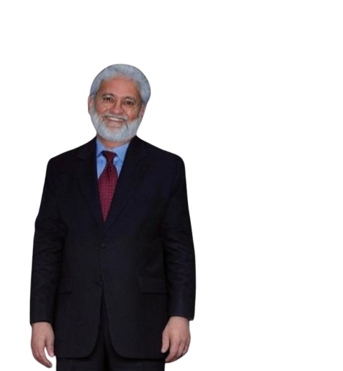
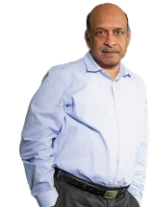



Our Advisory Board
Anil Mehta
Sudhin Choksey
Suneel Gautam
Founder of India Shelter Finance Corporation, Director at Edgrow Pvt Ltd, Ambit Finvest Pvt Ltd, Spocto Services Pvt Ltd and Cred Avenue Pvt Ltd
Chairman at India Shelter Finance Corporation, Independent Director
at Catholic Syrian Bank
Founder of Clea Public Relations, Founder of Hanmer & Partners, Co-founder of Pitchfork Partners
Amit Badiyani
Bhavesh Vora
Founder and CEO of Harrier Information Systems
MD & CEO of SERNET Financial Services

Slide 15


Partnership with Harrier Information Systems Private Limited
Athena and Harrier Information Systems are partnering to unlock synergies and drive innovation, delivering faster, smarter and seamless solutions for our clients.
Athena CredXpert
Harrier Information Systems Private Limited

Slide 16









We Got Featured !

Slide 17





Contact Us
Satish Mehta
Founder & CEO
satish@athenacredxpert.com
Mobile- +91 98201 23560
Mitushi Chaurasia Co-Founder & COO
mitushi@athenacredxpert.com
Mobile- +91 97022 34065
https://athenacredxpert.com
212, Maker Chamber V, Nariman Point, Mumbai – 400021, India
2nd floor, WeWork, Express Towers, Nariman Point, Mumbai – 400021, India
Reach us on

Slide 18

THANK YOU

